Slide 1


@alicerugglestrust
www.alicerugglestrust.org
Recognising and Responding to Stalking
The Alice Ruggles Trust
Notes:
Play as students enter: Blondie’s ‘One Way or Another’ (https://www.youtube.com/watch?v=_zBwRDEFMRY or ‘Every Step You Take’ by The Police can be played as students enter the assembly space (https://www.youtube.com/watch?v=OMOGaugKpzs .
Once you have played the songs:
Hi! I'm ... and today I'm going to be speaking with you about how we can recognize and respond to stalking...
You’ve just been listening to a song that might seem familiar to many of you. At first glance, you might think these are love songs. After all, they’re catchy, memorable, and often played in romantic movies, but actually this is a song about stalking and obsession, and this can be very dangerous as it was for Alice who was stalked and then murdered by an ex-partner.

Slide 2
@alicerugglestrust
www.alicerugglestrust.org
Who are we?
The Alice Ruggles Trust is a charity that educates young people under 25 about stalking.
It is our vision to prevent what happened to Alice happening to others. To bring stalking to an end.
Notes:
I'm here today presenting on behalf of The Alice Ruggles Trust. The trust is a charity that educates young people under 25 about stalking.
It is our vision to prevent what happened to Alice happening to others. To bring stalking to an end.

Slide 3
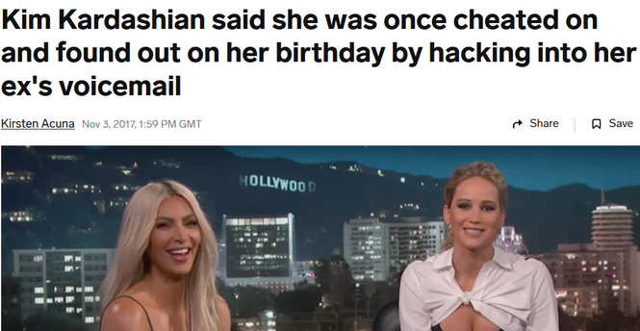
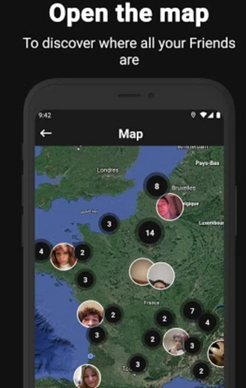
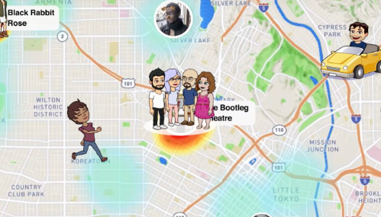
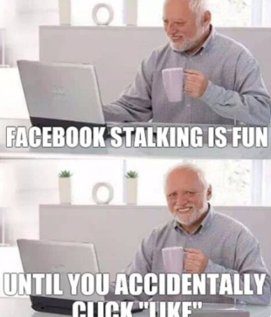
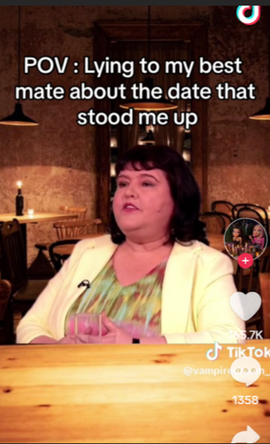
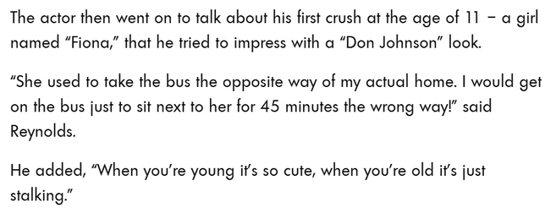
@alicerugglestrust
www.alicerugglestrust.org
Can you think of real life stalking examples?
Celebrity Behaviours
Social Media Maps
Memes
Notes:
Let’s start by talking about examples of stalking in everyday life. Can you think of any?
(Pause for responses.)
Some examples might surprise you. It is alarming how modern technology has made it easier for people to track and monitor others without their consent. Apps like Snapchat Maps, BeReal Maps, and Life360 allow individuals to locate and follow others in real-time, often without their knowledge.
These actions are further normalised by the behavior of celebrities, such as when Kim Kardashian publicly admitted to hacking into her ex's voicemail. While these incidents may be dismissed as harmless or even humorous, they set a dangerous precedent. We even see this humour reinforced in memes about obsessive behaviours.
Films and tv series often portray stalking behaviours as romantic or desirable. A persistent admirer showing up uninvited or following someone around is frequently framed as love, when in reality, it’s unhealthy and invasive.
In popular culture, stalking is often glamorised, and this reinforces and normalises unhealthy relationship behaviours which are not ok. ‘No doesn’t mean no’.
When we normalise these behaviours, we are saying people aren't supposed to be upset by them but that just isn't the case. You are allowed to feel uncomfortable or concerned by someone's repeated behaviours and you are allowed to say so.

Slide 4
@alicerugglestrust
www.alicerugglestrust.org
What is stalking?
Stalking is a pattern of repeated, unwanted behaviour that makes you feel uncomfortable and uneasy.
Notes:
Stalking is a pattern of repeated, unwanted behaviour that makes you feel uncomfortable and uneasy. It affects 523,000 young people aged 16-24 experience stalking each year
What does this definition mean?
A pattern is… something that happens over and over again. This might not be the same behaviour, but the behaviours are done for the same reason - to get your attention.
Research says that stalking victims experience 100 incidents before speaking up. We want to support people to come forward much sooner.
Unwanted means…You do not want this person to be in your life in the way that they want. This can be complicated if you’re in the same friendship group or classes, but your ‘no’ needs to be respected.
It is important to remember that stalking is a crime, and it has been illegal since 2012.
Alice took time to seek help as she did not initially recognise the risks she faced, but we urge you to seek help sooner if you’re experiencing patterns of unwanted, repeated behaviours.

Slide 5
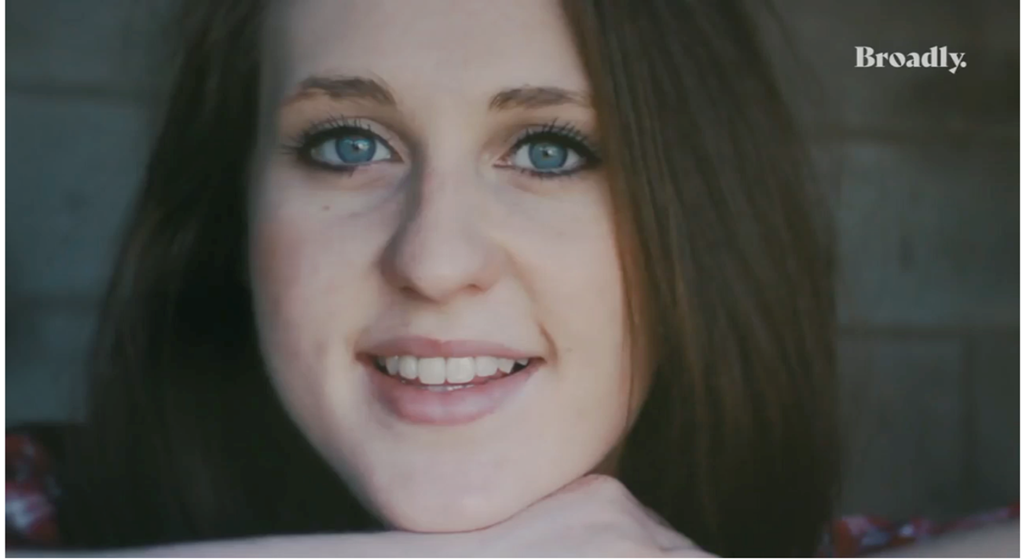
@alicerugglestrust
www.alicerugglestrust.org
Alice’s Story
This video tells Alice’s story, and it can be tough to watch.
Please take care of yourself (e.g., leave the room or take a break if needed). ​ If you need support, we encourage you to seek help.​
And please remember that things have changed since Alice’s passing.
Trigger warnings: violence, domestic abuse, stalking
Notes:
This video tells Alice’s story, and it can be tough to watch.
Please do what you need to take care of yourself, even if that means leaving the room or taking a break. If you need support, we encourage you to seek help from your teacher. Unhealthy relationships are an issue amongst all types of relationships, no matter gender, sexuality, class, ability, religion, or race.
Alice was kind, clever and beautiful. She loved life, loved her friends and loved her job. She had so much to live for. Tragically, Alice was murdered in Gateshead on 12 October 2016, aged just 24.
The police are much better at dealing with this now, but Alice would have sought help sooner if she had understood the danger she was in, and it is important that it is taken seriously before things escalate out of control.
The message that we are trying to spread is to take it seriously and act quickly.
PLAY VIDEO AFTER SAYING ALL OF THE ABOVE

Slide 6
@alicerugglestrust
www.alicerugglestrust.org
What is stalking?
  Many of you will experience, witness or even engage in repeated, unwanted behaviour at some point in your lives, some of which may represent stalking. ​
  Therefore, it is important to develop an understanding of unhealthy relationship behaviours and stalking. ​​
Notes:
Read Slide out then say
We are now going to present you with three brief scenarios and ask you to think about how the target of the behaviours (Taylor) may feel.

Slide 7
@alicerugglestrust
www.alicerugglestrust.org
Is this stalking?
Alex repeatedly sends Taylor gifts and notes despite Taylor’s lack of interest.
How may Taylor feel?
Notes:
Do a hands up with eyes shut...
Please shut your eyes and...
1. Hands up if you think Taylor may feel uncomfortable and embarrassed.
2. Hands up if you think Taylor may feel flattered

Slide 8
@alicerugglestrust
www.alicerugglestrust.org
Is this stalking?
Alex creates multiple fake profiles to follow Taylor on social media after being blocked. Alex sends Taylor numerous friend requests and messages from these fake accounts.
How may Taylor feel?
Notes:
1. Hands up if you think Taylor may feel scared and overwhelmed
2. Hands up if you think Taylor may feel amused and unconcerned.

Slide 9
@alicerugglestrust
www.alicerugglestrust.org
Is this stalking?
Alex checks Taylors snapchat maps to see where they are. Alex then turns up at these places. On school days Alex waits outside Taylor’s classes and constantly tries to walk them home.
How may Taylor feel?
Notes:
1. Hands up if you think Taylor may feel flattered by the attention
2. Hands up if you think Taylor may feel uncomfortable and uneasy

Slide 10
@alicerugglestrust
www.alicerugglestrust.org
Some stalking behaviours
Any pattern of repeated and unwanted behaviour
Online
E.g., tracking your movements, hacking your social media, setting up fake accounts, sharing ‘risky’ photos without your permission.
Offline
Random
E.g., following or showing up wherever you go; unwanted contact, messages or gifts.​
E.g., accusing you of stalking, constant memes, unwanted pizza orders, threats of suicide
Notes:
Stalking behaviours are any pattern of repeated and unwanted actions that make someone feel unsafe or uncomfortable.
These behaviours can happen online, offline, or even randomly.
For example --- pick an example from each to draw out to the students. Key to remember that this list does not include everything.
Even if one action seems small, when repeated, they can build up and become extremely distressing

Slide 11
@alicerugglestrust
www.alicerugglestrust.org
What if I do some of these things?
It’s normal to have intense emotions, especially when you’re growing up. But it’s important to remember that you’re in control of your own behaviour.​
If you find yourself becoming fixated on someone, obsessively messaging someone, showing up uninvited, or tracking their social media, it can make them feel uncomfortable and unsafe. ​
Listen if someone asks you to stop and seek advice from a trusted adult (e.g., school teacher, nurse or counsellor) if you’re unsure about your behaviour.
Notes:
Read verbatim

Slide 12
@alicerugglestrust
www.alicerugglestrust.org
What can we learn from this?
  Respect boundaries.​
  Understand the impact your behaviour, even innocent behaviour, may have on other people. ​
  Change your behaviour when necessary. ​
  Seek support.
Notes:
These actions create a pattern of repeated, unwanted behaviours that can be harmful to both individuals involved. For the person being followed, this behaviour can lead to feelings of fear and discomfort, affecting their daily life and sense of safety. For the person engaging in these actions, it reflects an unhealthy focus on another person, which can be damaging to their well-being as well. It's important to recognize that this kind of behaviour is not respectful or healthy. So, what can we learn from this?
Read out slide

Slide 13


@alicerugglestrust
www.alicerugglestrust.org
If you think you’re being stalked
Trust your instincts and stay safe
  Log the behaviours (e.g., diary of dates and time) and gather evidence (e.g., screenshots and saved emails). ​
  Talk to people you trust about what is happening (e.g., a friend or guardian, a teacher or school counsellor,
a helpline). ​
  Report the behaviours if you are concerned.
LOG
TALK
REPORT
Notes:
If you ever feel like someone’s repeated actions are making you uncomfortable, unsafe, or worried, it’s important to take uncomfortable behaviour seriously early on. It is never your fault.
First, log the behaviours. Keep a record of what’s happening—write down dates, times, and details in a diary. Save evidence like screenshots, messages, or emails. This will help you build a clear picture of what’s going on. For help with this, you can visit the Alice Ruggles Trust website to download a free diary that can help you keep track of these instances.
Next, talk to people you trust. Share what’s happening with someone who can support you, like a friend, family member, teacher, or school counsellor. You can also reach out to a helpline such as the national stalking helpline—they’re there to listen and provide advice.
Finally, report the behaviours to the police if you’re concerned.
Remember, you don’t have to deal with this alone—there are people and resources ready to help you.

Slide 14
@alicerugglestrust
www.alicerugglestrust.org
Helping a friend
  Be there for them​
  Be patient​
  Listen and believe​
  Don’t judge​
  Tell them it’s not their fault​
  Remind them they are not alone
Help your friend to:
Log the behaviour​s
Talk to other people​
Report the behaviours
Notes:
Stalking can be overwhelming, and it might take a while for your friend to speak up or take action. Did you know that it often takes about 100 incidents before someone seeks help? So, if they don’t confide in you right away, don't take it personally. Let them know that you’re there whenever they’re ready to talk.
One of the most important things you can do is to listen without judgment. Believe them when they share their experience and remind them that it’s not their fault.
You could also help you friend to log the behaviours via diaries, encourage them to talk to people they trust, explore the available options with them such as researching support helplines with them, and if they are concerned to report the behaviours to report it to the police.
Supporting a friend through this can be challenging, but your patience, understanding, and encouragement can make all the difference. Just be there for them, listen, and remind them that they are not alone. But do not put yourself at risk, never confront the abuser or act as a go-between

Slide 15

@alicerugglestrust
www.alicerugglestrust.org
Remember
  If someone won’t accept ’no’ or does not listen when you ask them to ‘stop’:​
  It’s not your fault.​
  It is okay to change your mind, no means no at any point.​
  You should not accept repeated, unwanted behaviours.​
  Trust your instincts and stay safe.
Log
Talk
Report
the behaviours
to other people​
the behaviours
Notes:
Read Verbatim

Slide 16


www.alicerugglestrust.org
@alicerugglestrust
Sources of support:
  School. Teacher, nurse, counsellor.​
  Police. 999 or 101.​
  Alice Ruggles Trust. alicerugglestrust.org.​
  Paladin Service. Offers stalking support and specialist young people services: www.paladinservice.co.uk
020 3866 4107, info@paladinservice.co.uk.​
  Suzy Lamplugh Trust. Offers national stalking helpline: https://www.suzylamplugh.org,
0808 802 0300, info@suzylamplugh.org.​
  Respect. Offers support to those exhibiting controlling behaviours:
0808 802 4040.​
  Men’s Advice Line. Offers support to men with controlling partners:
0808 801 0327.​
  The CyberHelpline. Offers support for victims of cyber-crime and online harms:
https://www.thecyberhelpline.com​
  Victim Care and Advice Service. Offers support to people recovering from the affects of the crime:
0800 138 2020
Notes:
Here are some support services, please as you are leaving read through them and they are also on the back of your leaflets

