Slide 1





Stalking Awareness:
Recognising the Signs & Staying Safe
NSAW 2025
Notes:
Play as students enter: Blondie’s ‘One Way or Another’ (https://www.youtube.com/watch?v=_zBwRDEFMRY or ‘Every Step You Take’ by The Police can be played as students enter the assembly space (https://www.youtube.com/watch?v=OMOGaugKpzs .
Once you have played the songs:
Today we're going to be talking about how we can recognize and respond to stalking...
You’ve just been listening to a song that might seem familiar to many of you. At first glance, you might think these are love songs. After all, they’re catchy, memorable, and often played in romantic movies, but actually this is a song about stalking and obsession, and this can be very dangerous - especially if we don't know about the signs to look out for.

Slide 2
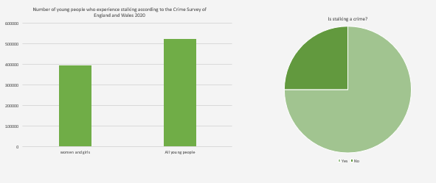
Facts you need to know
Notes:
Stalking is a pattern of repeated, unwanted behaviour that makes you feel uncomfortable and uneasy. It affects 523,000 young people aged 16-24 experience stalking each year.
Of those who have experienced these behaviours, only 28% recognised that they might be linked to stalking.
This means that almost 3/4 of those who have been exposed to stalking behaviours are unaware of what they are. It's important to discuss this topic, to keep ourselves and each other safe.

Slide 3
‘It was dismissed as either my own anxiety or him having a schoolboy crush. It isn't either of those things’
Notes:
Often stalking behaviours aren't understood, can be minimised or trivialised - especially when they involve young people such as you.
The quote here shows the thoughts of a girl, who experienced stalking from a boy of a similar age.
Even though she was sure of what was happening, her concerns weren't taken seriously.
It's vital that we talk about these issues - to both adults and children to have avoid these misconceptions.

Slide 4
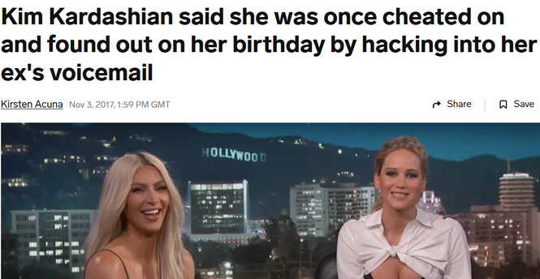
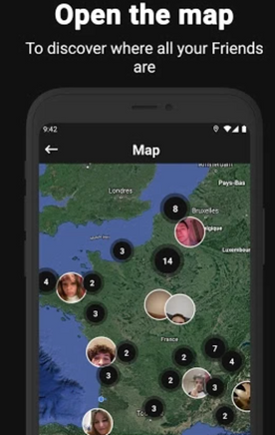
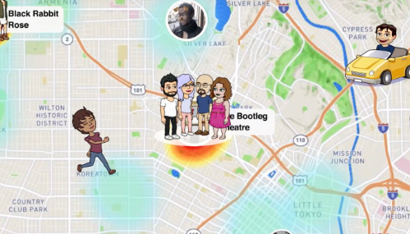
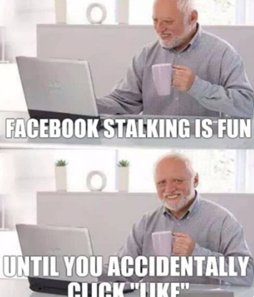
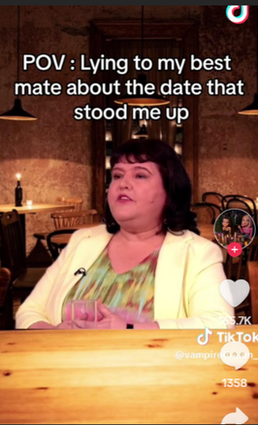
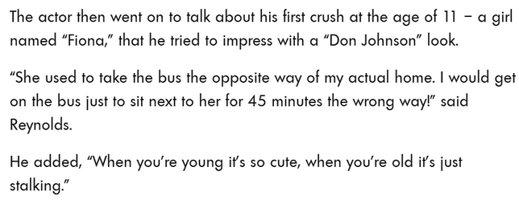
Can you think of real life stalking examples?
Celebrity Behaviours
Social Media Maps
Memes
Notes:
Let’s start by talking about examples of stalking in everyday life. Can you think of any?
(Pause for responses.)
Some examples might surprise you. It is alarming how modern technology has made it easier for people to track and monitor others without their consent. Apps like Snapchat Maps, BeReal Maps, and Life360 allow individuals to locate and follow others in real-time, often without their knowledge.
These actions are further normalised by the behavior of celebrities, such as when Kim Kardashian publicly admitted to hacking into her ex's voicemail. While these incidents may be dismissed as harmless or even humorous, they set a dangerous precedent. We even see this humour reinforced in memes about obsessive behaviours.
Films and tv series often portray stalking behaviours as romantic or desirable. A persistent admirer showing up uninvited or following someone around is frequently framed as love, when in reality, it’s unhealthy and invasive.
In popular culture, stalking is often glamorised, and this reinforces and normalises unhealthy relationship behaviours which are not ok. ‘No doesn’t mean no’.
When we normalise these behaviours, we are saying people aren't supposed to be upset by them but that just isn't the case. You are allowed to feel uncomfortable or concerned by someone's repeated behaviours and you are allowed to say so.

Slide 5
What is stalking?
Stalking is a pattern of repeated, unwanted behaviour that makes you feel uncomfortable and uneasy.
Notes:
Stalking is any pattern of repeated, unwanted behaviour that makes you feel uncomfortable and uneasy. It affects 523,000 young people aged 16-24 experience stalking each year
What does this definition mean?
A pattern is… something that happens over and over again. This might not be the same behaviour, but the behaviours are done for the same reason - to get your attention.
Research says that stalking victims experience 100 incidents before speaking up. We want to support people to come forward much sooner.
Unwanted means…You do not want this person to be in your life in the way that they want. This can be complicated if you’re in the same friendship group or classes, but your ‘no’ needs to be respected.
It is important to remember that stalking is a crime, and it has been illegal since 2012.
We may take time to seek help as we may not initially recognise the risks but it's important to seek help as soon as you can if you’re experiencing patterns of unwanted, repeated behaviours from someone.

Slide 6
Is this stalking?
Alex repeatedly sends Taylor gifts and notes despite Taylor’s lack of interest.
How may Taylor feel?
Notes:
Do a hands up with eyes shut...
Please shut your eyes and...
1. Hands up if you think Taylor may feel uncomfortable and embarrassed.
2. Hands up if you think Taylor may feel flattered
Take this opportunity to talk about the fact that we often dismiss these types of behaviour as not being serious or important - sometimes we might think (or be told) it's just a crush, you should feel flattered, it's not serious etc...
If Taylor is feeling uncomfortable or embarrassed we should encourage her to speak to someone about her feelings.

Slide 7
Is this stalking?
Alex creates multiple fake profiles to follow Taylor on social media after being blocked. Alex sends Taylor numerous friend requests and messages from these fake accounts.
How may Taylor feel?
Notes:
1. Hands up if you think Taylor may feel scared and overwhelmed
2. Hands up if you think Taylor may feel amused and unconcerned.
Reinforce the idea that for many years stalking was not taken seriously and was often the subject of jokes - this deeply ingrained attitude can be hard to ignore if others treat it in this way.
On the other hand Taylor may be feeling really scared - in which case we have advice on what to do in this presentation.

Slide 8
Is this stalking?
Alex checks Taylors snapchat maps to see where they are. Alex then turns up at these places. On school days Alex waits outside Taylor’s classes and constantly tries to walk them home.
How may Taylor feel?
Notes:
1. Hands up if you think Taylor may feel flattered by the attention
2. Hands up if you think Taylor may feel uncomfortable and uneasy
Draw out responses - use this as an opportunity to say that Alex's behaviours are becoming more fixated and worrying. At this point we would suggest that Taylor should be seeking support.

Slide 9
Some stalking behaviours
Any pattern of repeated and unwanted behaviour
Online
E.g., tracking your movements, hacking your social media, setting up fake accounts, sharing ‘risky’ photos without your permission.
Offline
Random
E.g., following or showing up wherever you go; unwanted contact, messages or gifts.​
E.g., accusing you of stalking, constant memes, unwanted pizza orders, threats of suicide
Notes:
Stalking behaviours are any pattern of repeated and unwanted actions that make someone feel unsafe or uncomfortable.
These behaviours can happen online, offline, or even randomly.
For example --- pick an example from each to draw out to the students. Key to remember that this list does not include everything.
Even if one action seems small, when repeated, they can build up and become extremely distressing

Slide 10
What if I do some of these things?
It’s normal to have intense emotions, especially when you’re growing up. But it’s important to remember that you’re in control of your own behaviour.​
If you find yourself becoming fixated on someone, obsessively messaging someone, showing up uninvited, or tracking their social media, it can make them feel uncomfortable and unsafe. ​
Listen if someone asks you to stop and seek advice from a trusted adult (e.g., school teacher, nurse or counsellor) if you’re unsure about your behaviour.
Notes:
Read verbatim

Slide 11




If you think you’re being stalked
Trust your instincts and stay safe
  Log the behaviours (e.g., diary of dates and time) and gather evidence (e.g., screenshots and saved emails). ​
  Talk to people you trust about what is happening (e.g., a friend or guardian, a teacher or healthcare professional,
a helpline). ​
  Report the behaviours if you are concerned.
LOG
TALK
REPORT
Notes:
If you ever feel like someone’s repeated actions are making you uncomfortable, unsafe, or worried, it’s important to take uncomfortable behaviour seriously early on. It is never your fault.
First, log the behaviours. Keep a record of what’s happening—write down dates, times, and details in a diary. Save evidence like screenshots, messages, or emails. This will help you build a clear picture of what’s going on. For help with this, you can visit the Alice Ruggles Trust website to download a free diary that can help you keep track of these instances.
Next, talk to people you trust. Share what’s happening with someone who can support you, like a friend, family member, teacher, or school counsellor. You can also reach out to a helpline such as the national stalking helpline—they’re there to listen and provide advice.
Finally, report the behaviours to the police if you’re concerned.
Remember, you don’t have to deal with this alone—there are people and resources ready to help you.

Slide 12
Can I talk to my GP about this?
A GP can help you with both your mental and physical health. They can:
✅ Listen to your experience in a safe and confidential space
✅Help with mental health issues stemming from the stalking, e.g. anxiety, stress, or sleep problems caused by stalking
✅ Refer you to counselors, therapists, or support groups
✅Offer advice on staying safe and managing your well-being
Notes:
There are lots of people that you can talk to about your worries - if you are experiencing stalking behaviours. These might be your parents or carers, an older sibling, a staff member at school or the police.
You may be finding it hard to cope physically/mentally/emotionally and if this is the case then you can speak to your GP about your worries. They can offer a range of help.
Read through slide...

Slide 13

Remember
  If someone won’t accept ’no’ or does not listen when you ask them to ‘stop’:​
  It’s not your fault.​
  It is okay to change your mind, no means no at any point.​
  You should not accept repeated, unwanted behaviours.​
  Trust your instincts and stay safe.
Log
Talk
Report
the behaviours
to other people​
the behaviours
Notes:
Read Verbatim

Slide 14

Sources of support:
  School. Teacher, nurse, counsellor.​
  Police. 999 or 101.​
  Alice Ruggles Trust. alicerugglestrust.org.
  ​Paladin Service. Offers stalking support and specialist young people services: www.paladinservice.co.uk 020 3866 4107, info@paladinservice.co.uk.​
  Suzy Lamplugh Trust. Offers national stalking helpline: https://www.suzylamplugh.org, 0808 802 0300, info@suzylamplugh.org.​
  Respect. Offers support to those exhibiting controlling behaviours: 0808 802 4040.​
  Men’s Advice Line. Offers support to men with controlling partners: 0808 801 0327.​
  The CyberHelpline. Offers support for victims of cyber-crime and online harms: https://www.thecyberhelpline.com​
  Healthcare professional
  Victim Care and Advice Service. Offers support to people recovering from the affects of the crime: 0800 138 2020
  Hollie Guard - a free personal safety app www.hollieguard.com
Notes:
Here are some support services

